Slide 1


Netflix Consumption analysis and Recommendation model
Submitted by:
FNU Deepanshu (A20449479)
Soumya Elizabeth Thomas (A20456962)
Venkata Sai Akshay Kishore Khanderao (A20458999)

Slide 2

Objective
Recommendation model- Goal is to recommend a movie or a TV show based on an already watched content. We are using Item-based Collaborative Filter Recommendation for this.

Slide 3

Data Collection
We use the Kaggle dataset in the link https://www.kaggle.com/shivamb/netflix-shows?select=netflix_titles.csv
https://www.kaggle.com/stefanoleone992/imdb-extensive-dataset
This dataset consists of TV shows and movies of Netflix, coupled with their Imdb-Ratings as of year 2019.

Slide 4
Data Preparation
Import data & necessary libraries
Dropping Duplicate values
Checking missing and categorical data
Split data into training, validation and evaluation sets

Slide 5
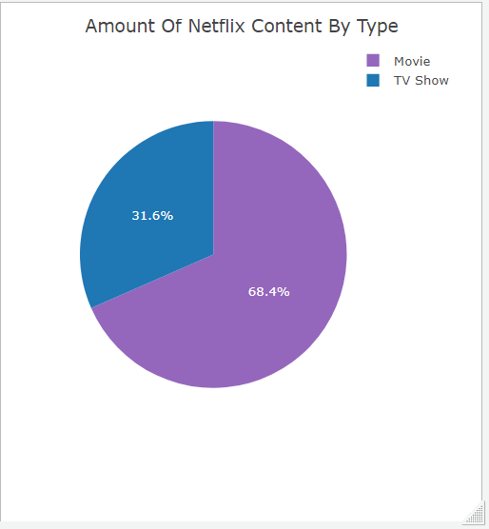
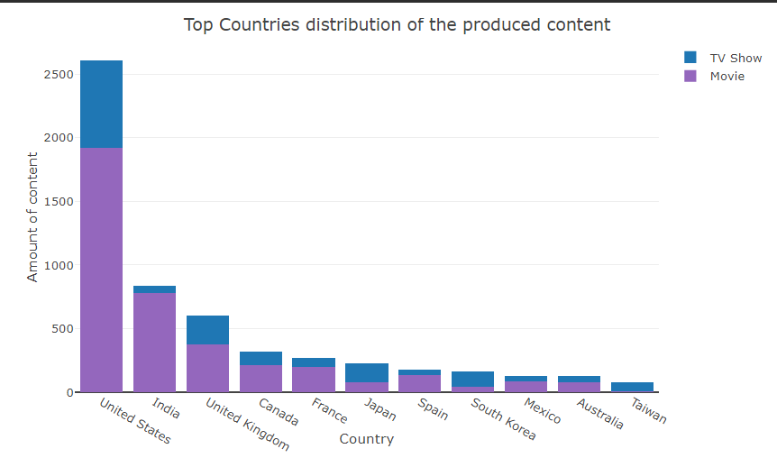
Exploratory Data Analysis
Ratio of TV Show vs Movies
Movies and TV shows, made by several countries

Slide 6
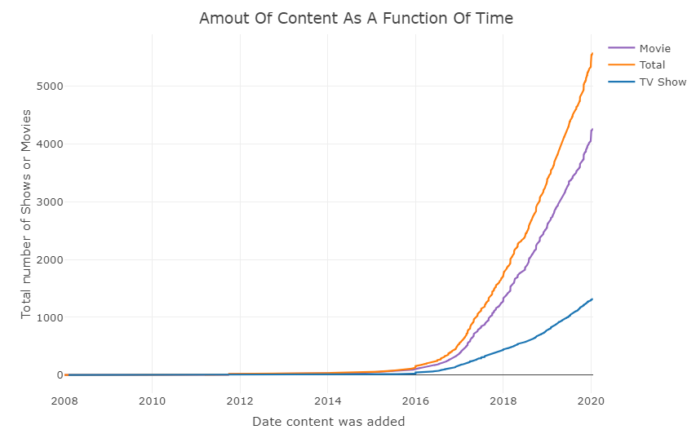
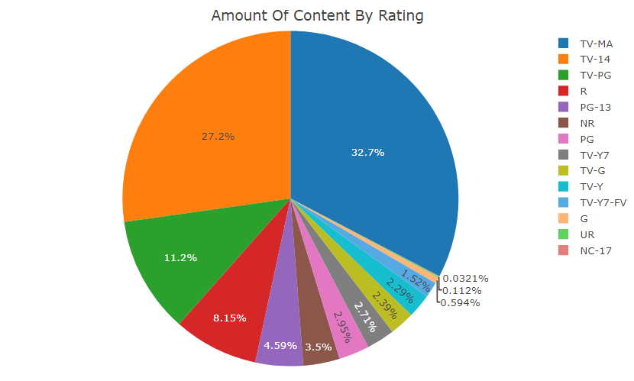
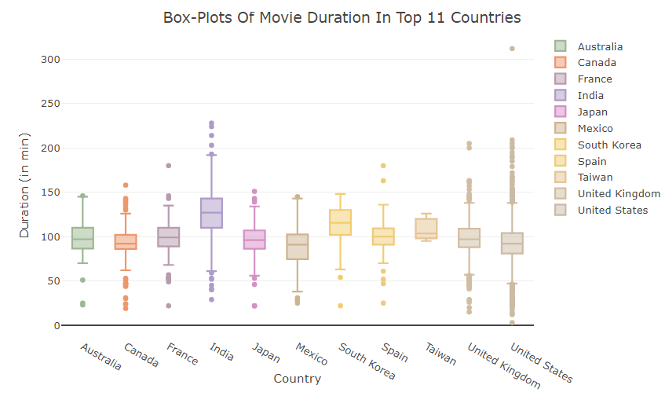
Total number of TV Shows /Movies
available on Netflix over the years
Distribution of content by rating classes
Movie Duration by Countries

Slide 7
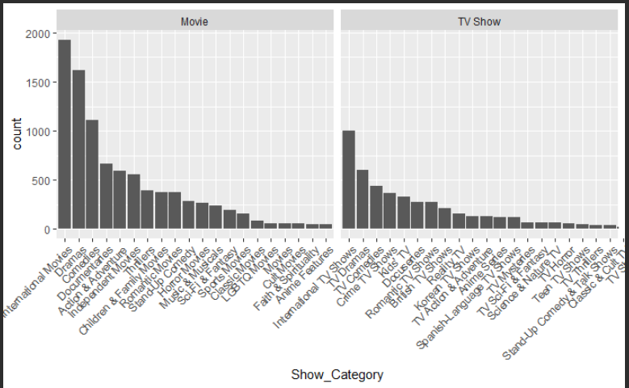
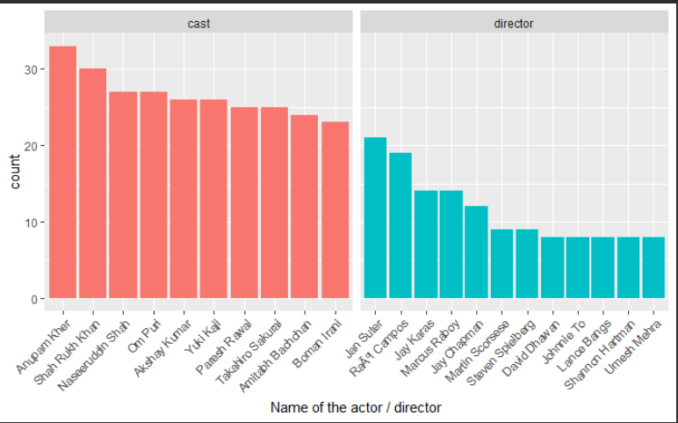
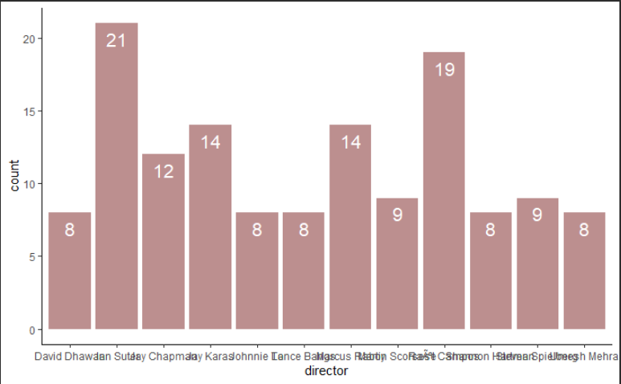
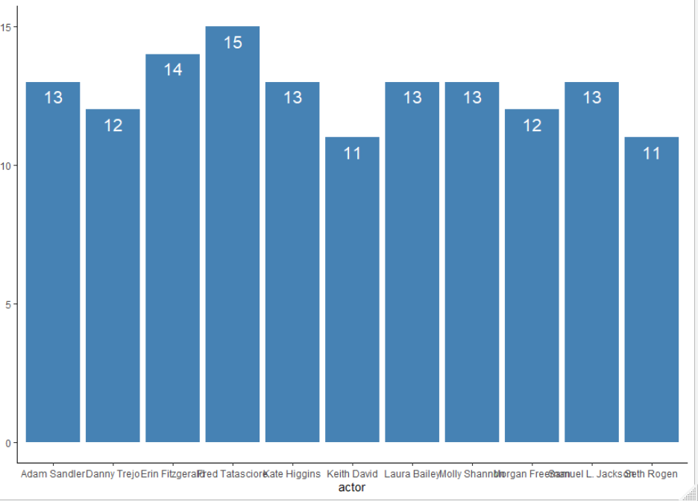
Most frequent movies or TV-shows categories
Prolific directors, actors who are associated with most movies
Top 10 directors and actors by the amount of content on Netflix

Slide 8
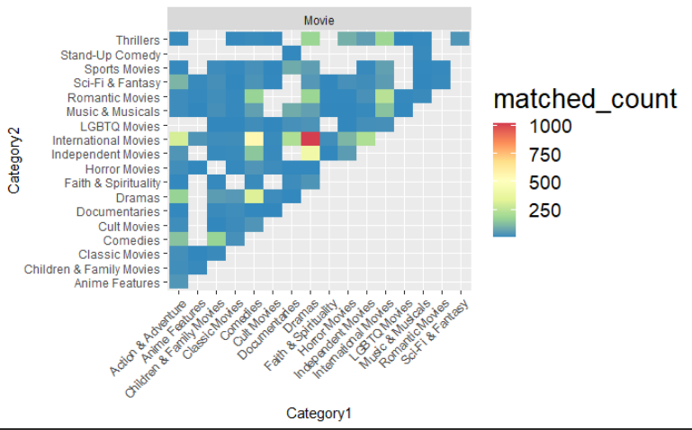
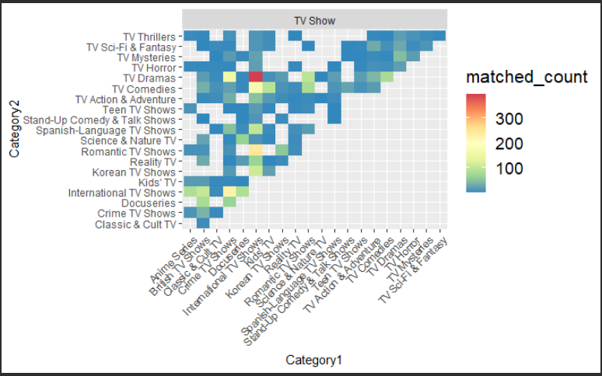
Correlation of categories with TV shows/movies

Slide 9

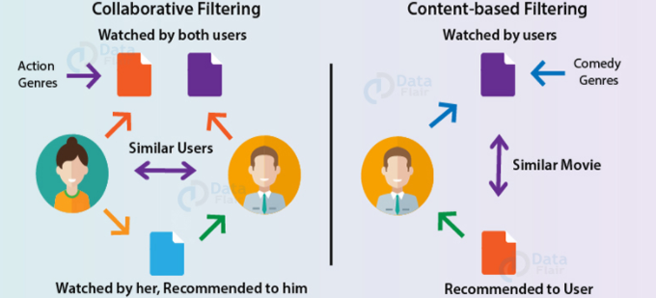


Modeling
A recommendation system provides suggestions to the users through a filtering process that is based on user preferences and browsing history.
– Collaborative Filtering Recommendation
– Content-Based Filtering Recommendation
We build a Netflix Recommendation System which provides recommendations of the movies that are similar to the ones that have been watched in the past.
Notes:
The information about the user is taken as an input. The information is taken from the input that is in the form of browsing data. This information reflects the prior usage of the product as well as the assigned ratings. A recommendation system is a platform that provides its users with various contents based on their preferences and likings. A recommendation system takes the information about the user as an input

Slide 10
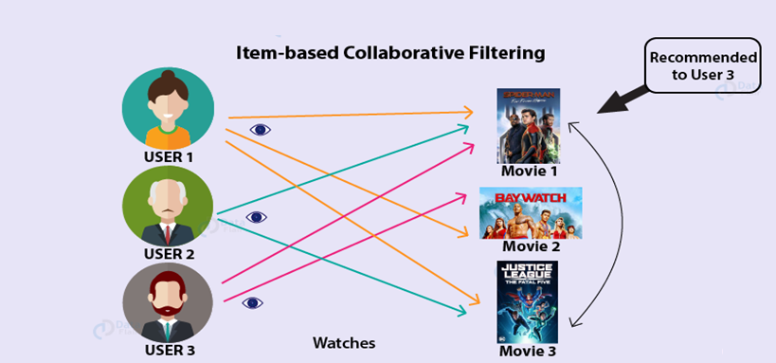
Item Based-CF is divided in two sub tasks:
1.Calculation of similarity among the items
Cosine-Based Similarity
Correlation-Based Similarity
Adjusted Cosine Similarity
1-Jaccard distance
2.Calculation of Prediction
Weighted Sum
Regression
In this CF method, instead of focusing on users' friends, we focus on what items from all the options are more similar to what we know the user enjoys. This new focus is known as Item-Based Collaborative Filtering (IB-CF).
In IB-CF, we directly pre-calculate the similarity between the co-rated items, skipping
K- neighborhood search.

Slide 11

Conclusion
OTT platforms are increasing exponentially.
It makes easy for the user to navigate through the content.
Collaborative filtering recommendation aims to calculate a list of interesting features to target users based on the preferences of other like-minded users.
Discrete features such as genres, directors, and actors of the movies has been used to generate a recommendation.

Slide 12

Future Work
To further this, we are implementing a rating prediction model that predicts the rating of the movies; for that, we are planning to use TFIDF for text processing and do the predict modeling.
We are also planning to implement collaborative filtering algorithm based on user preference clustering to reduce the data overload.

Slide 13

Thank you…

